Slide 1
2023 SIA
English conversation
- Civic center (former Mogi family residence, Noda city, Chiba)

Slide 2
Introduction

Slide 4
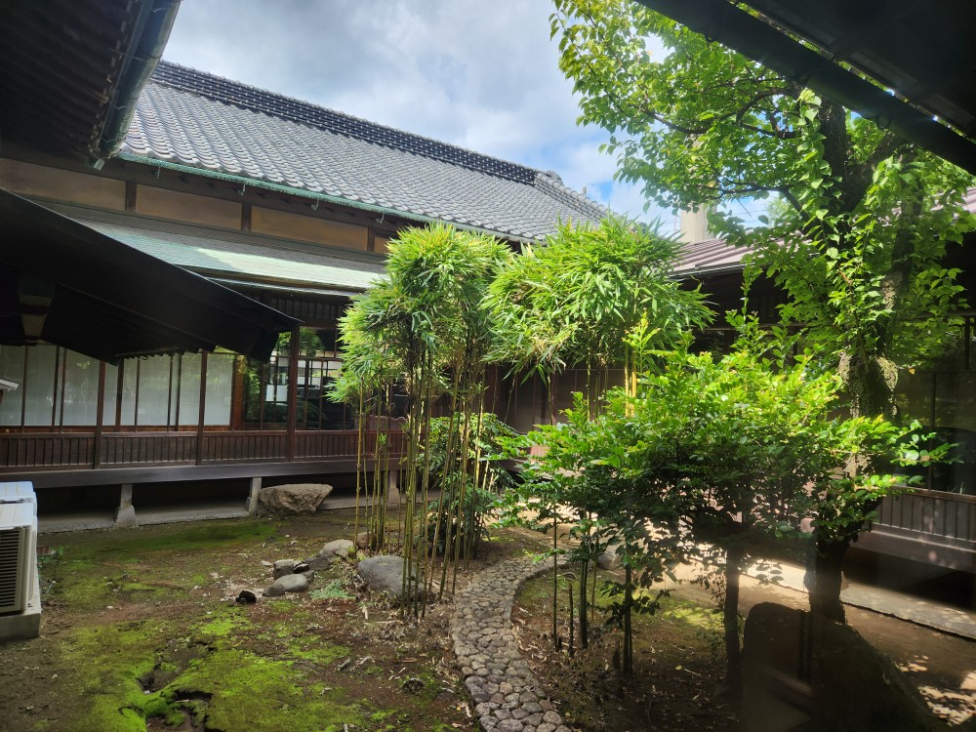
Mogi Saheiji residence
中庭

Slide 5
Parts of the house
Courtyard
Bathroom / toilet
Tatami room
Corridor
Furnace

Slide 6
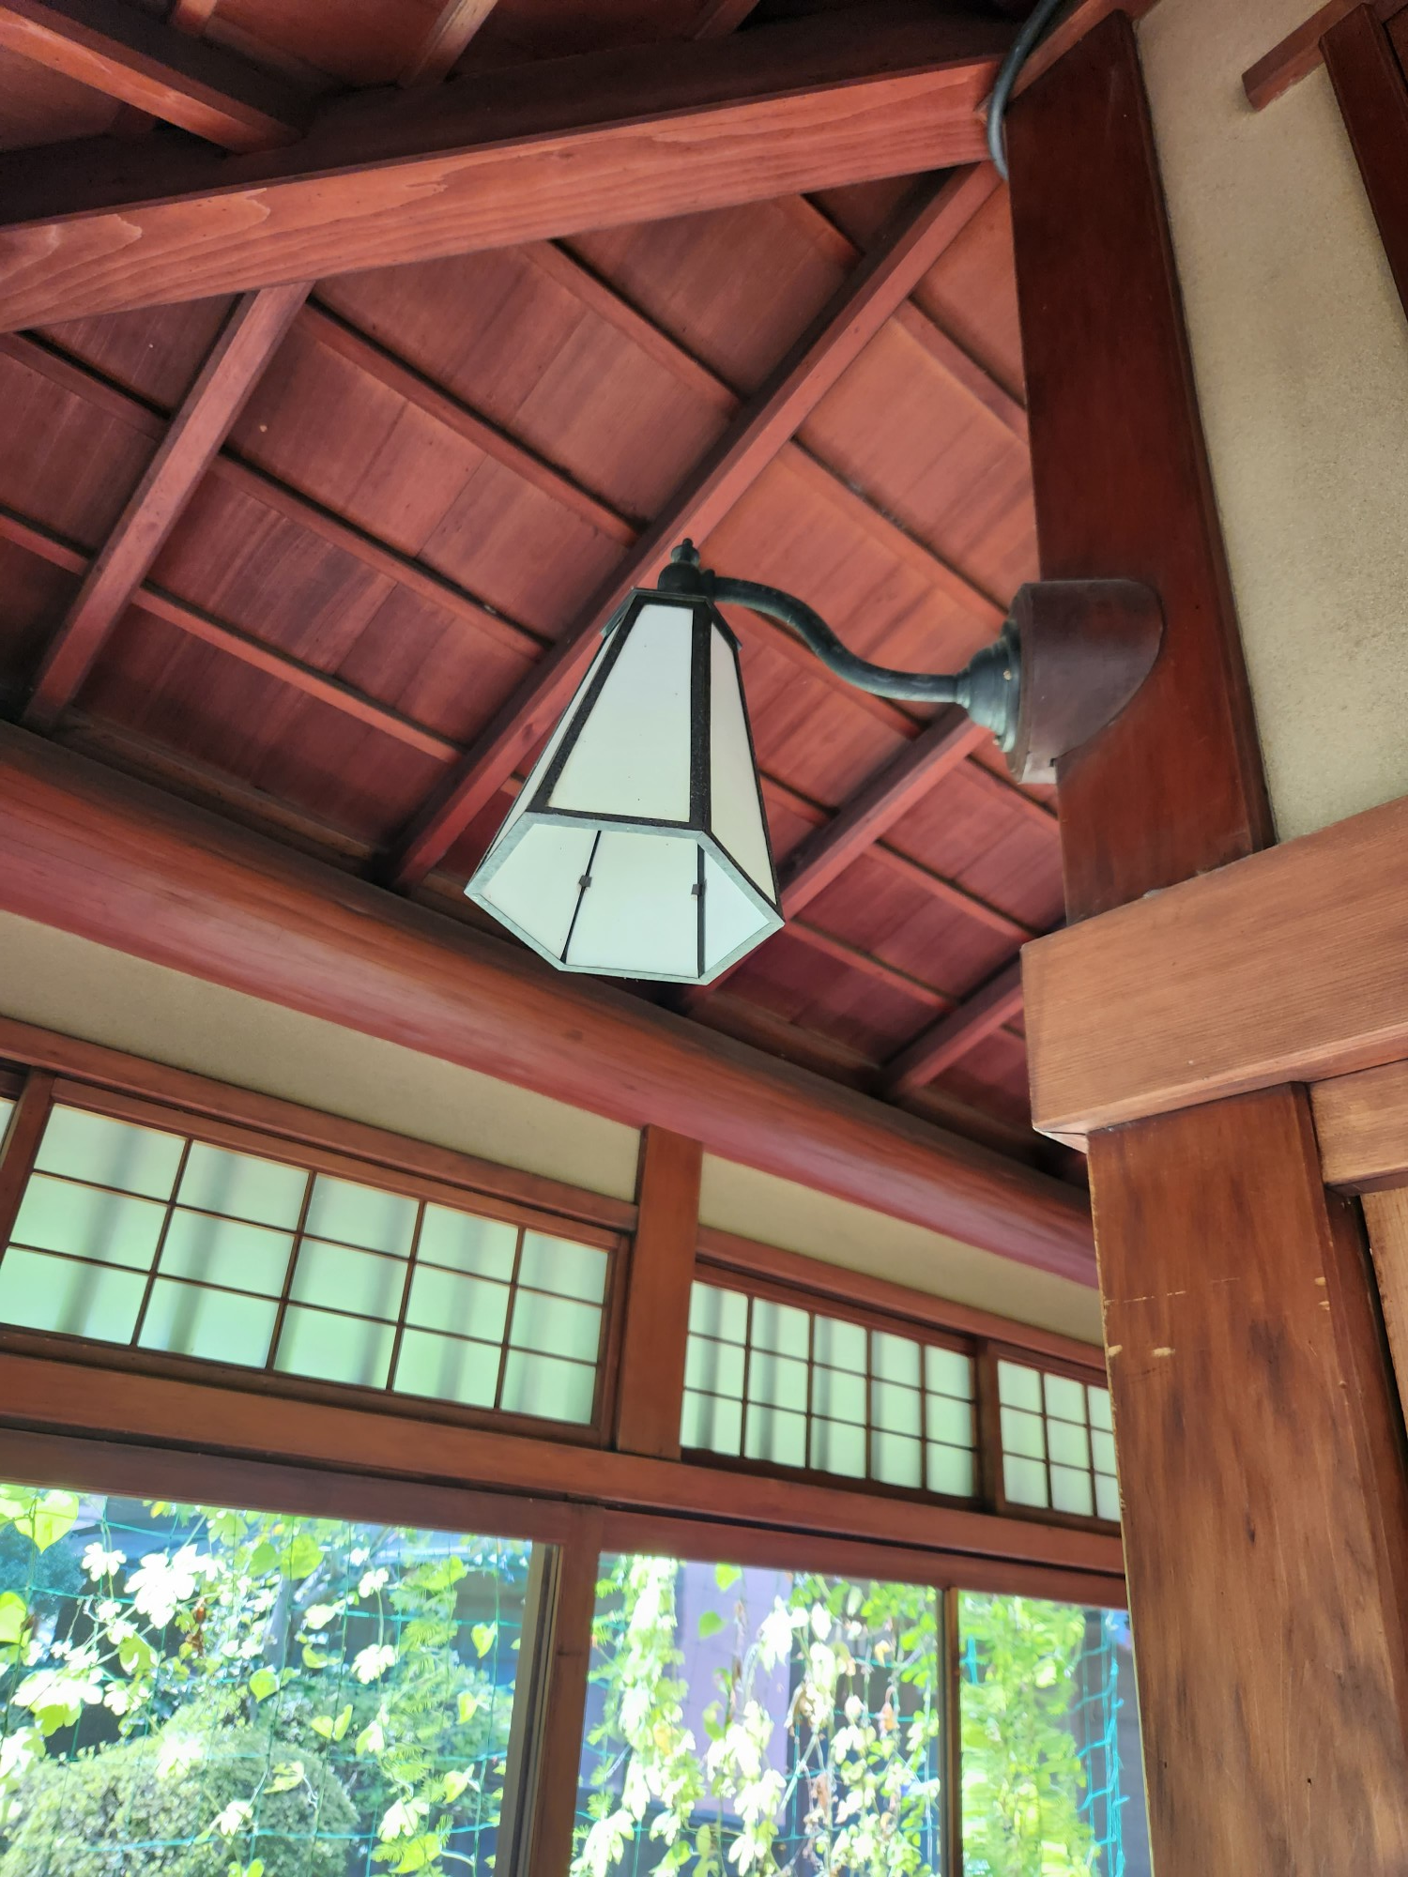
照明

Slide 7
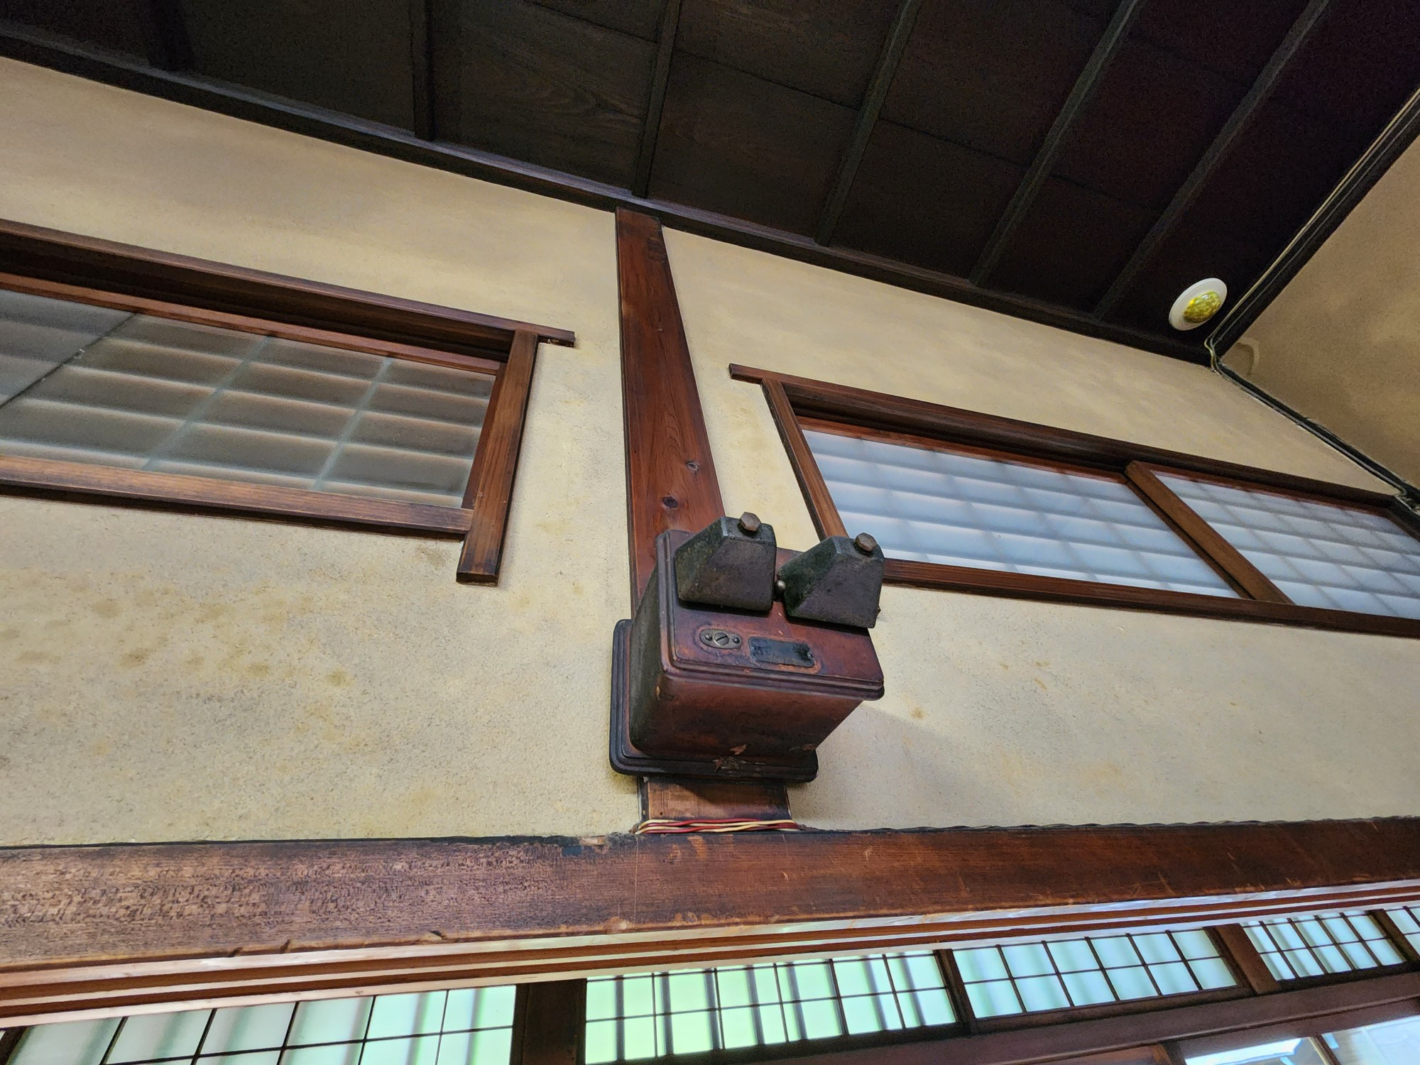

Slide 8
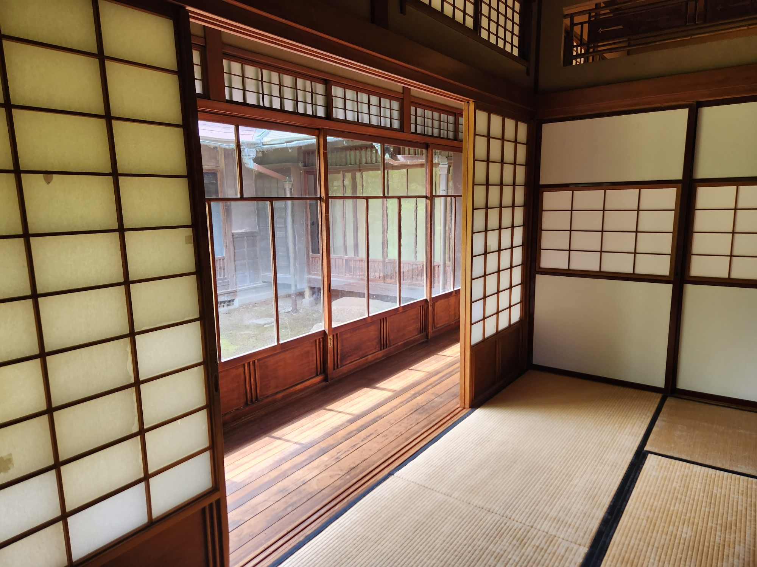
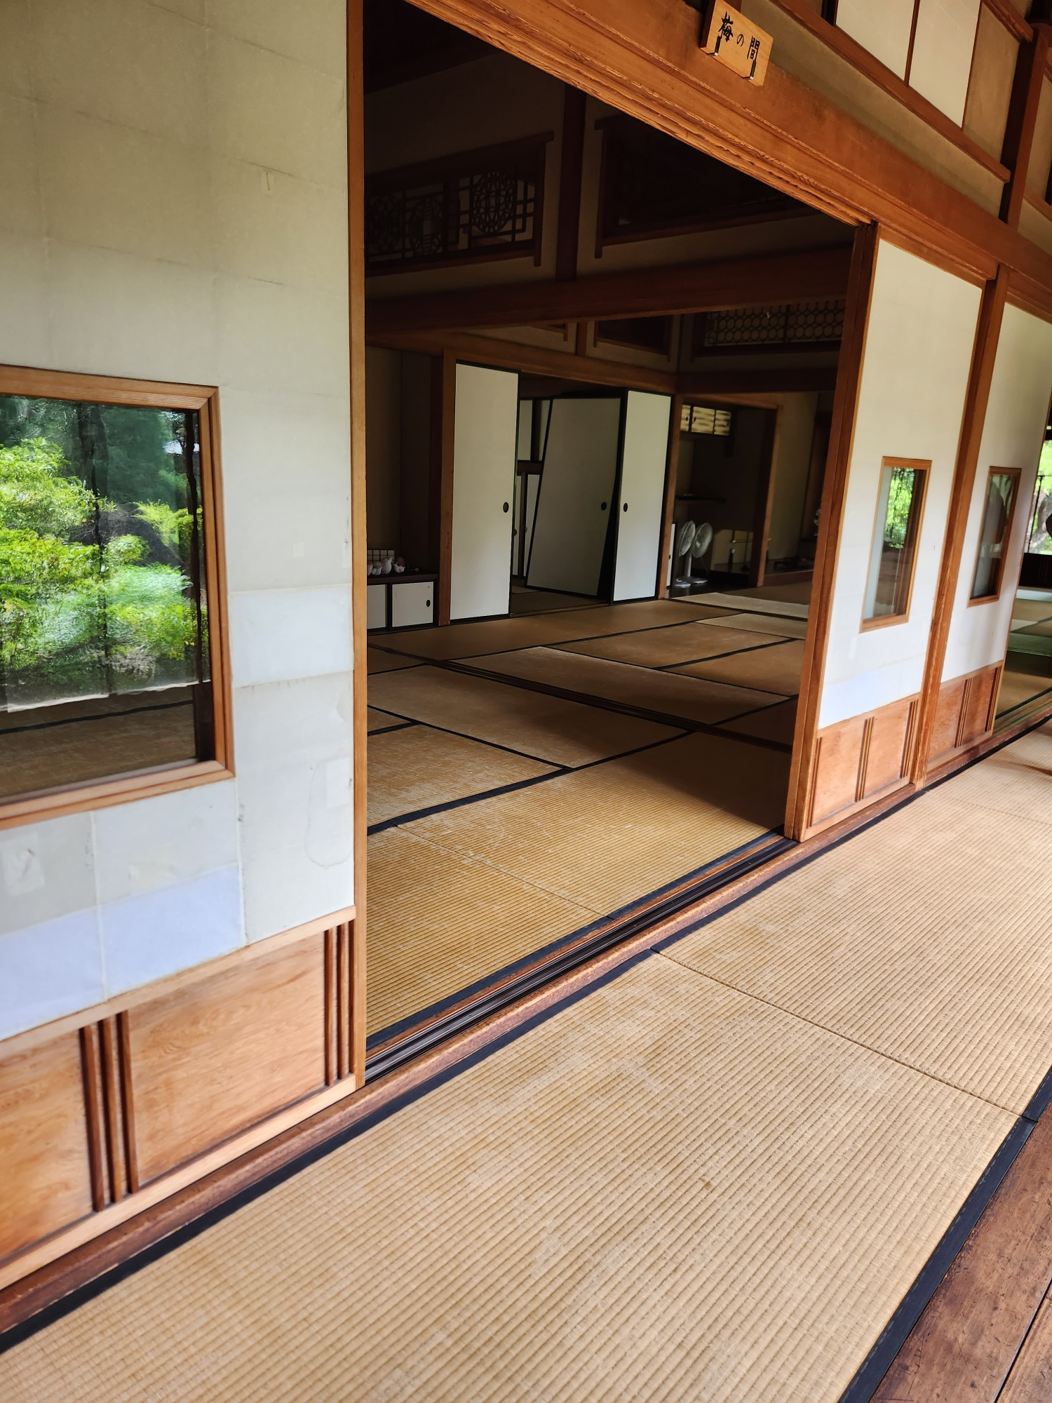
和室
Japanese room

Slide 9
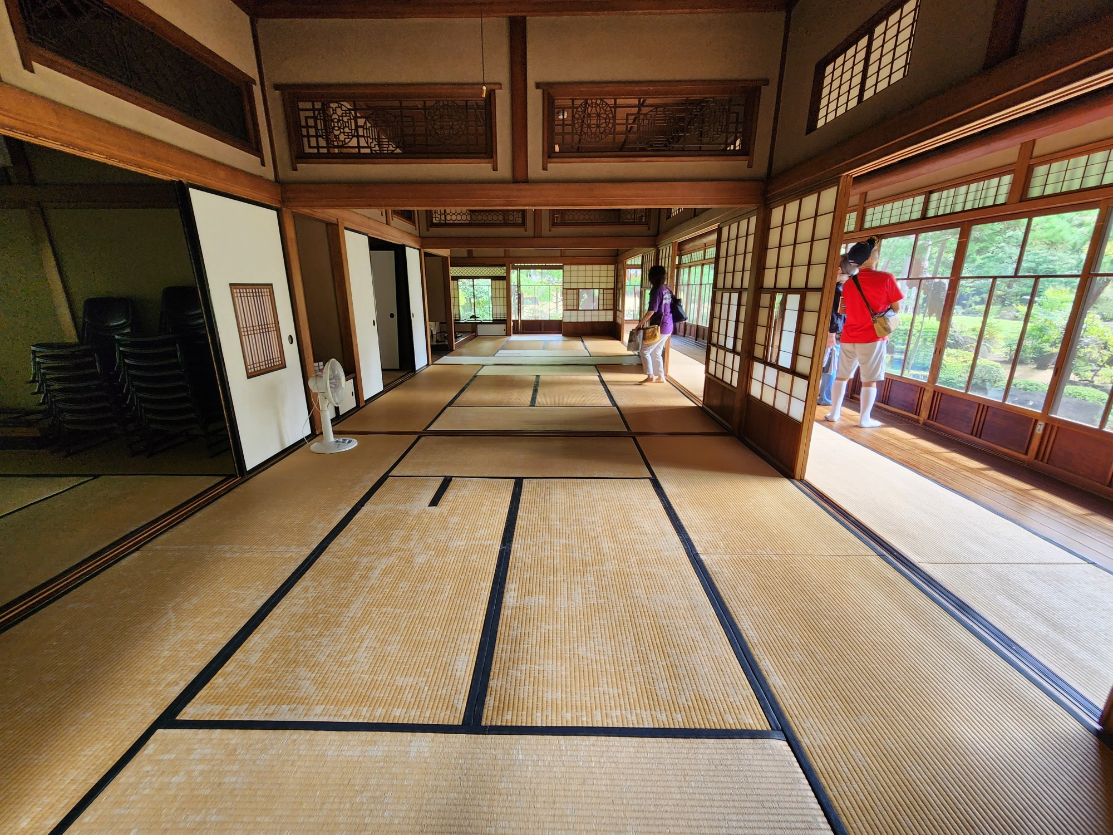
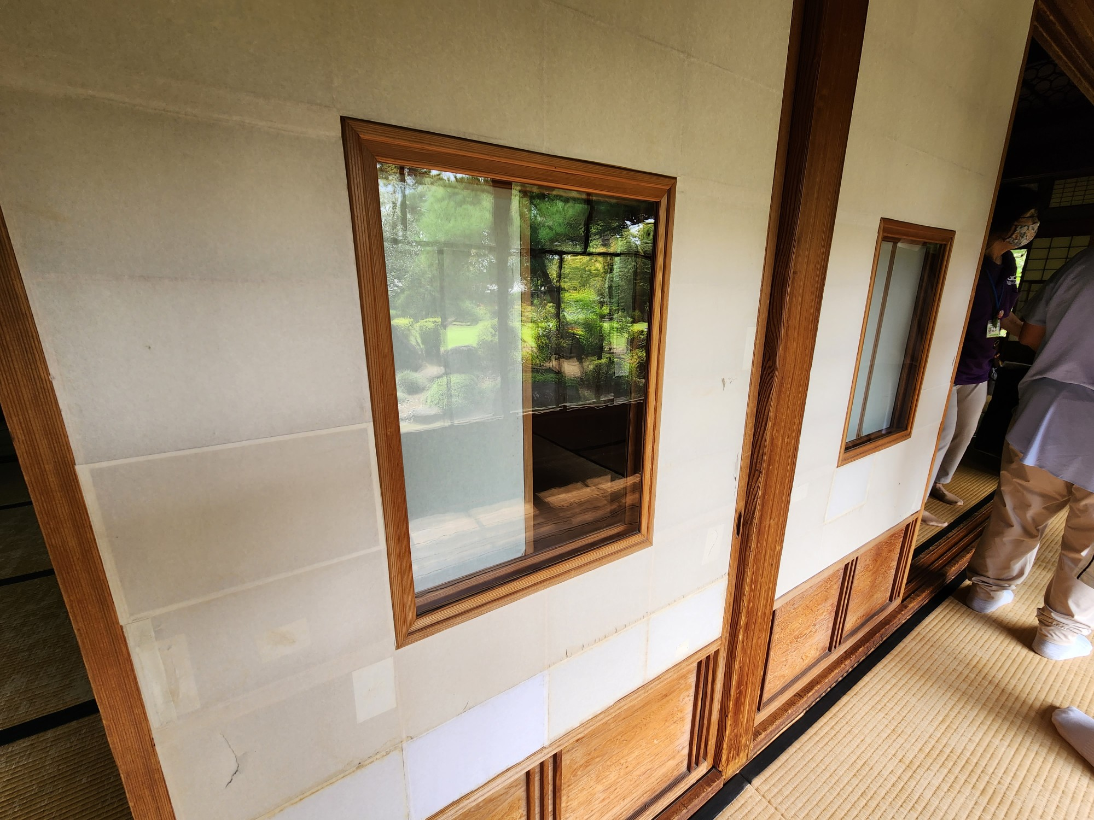
障子

Slide 10
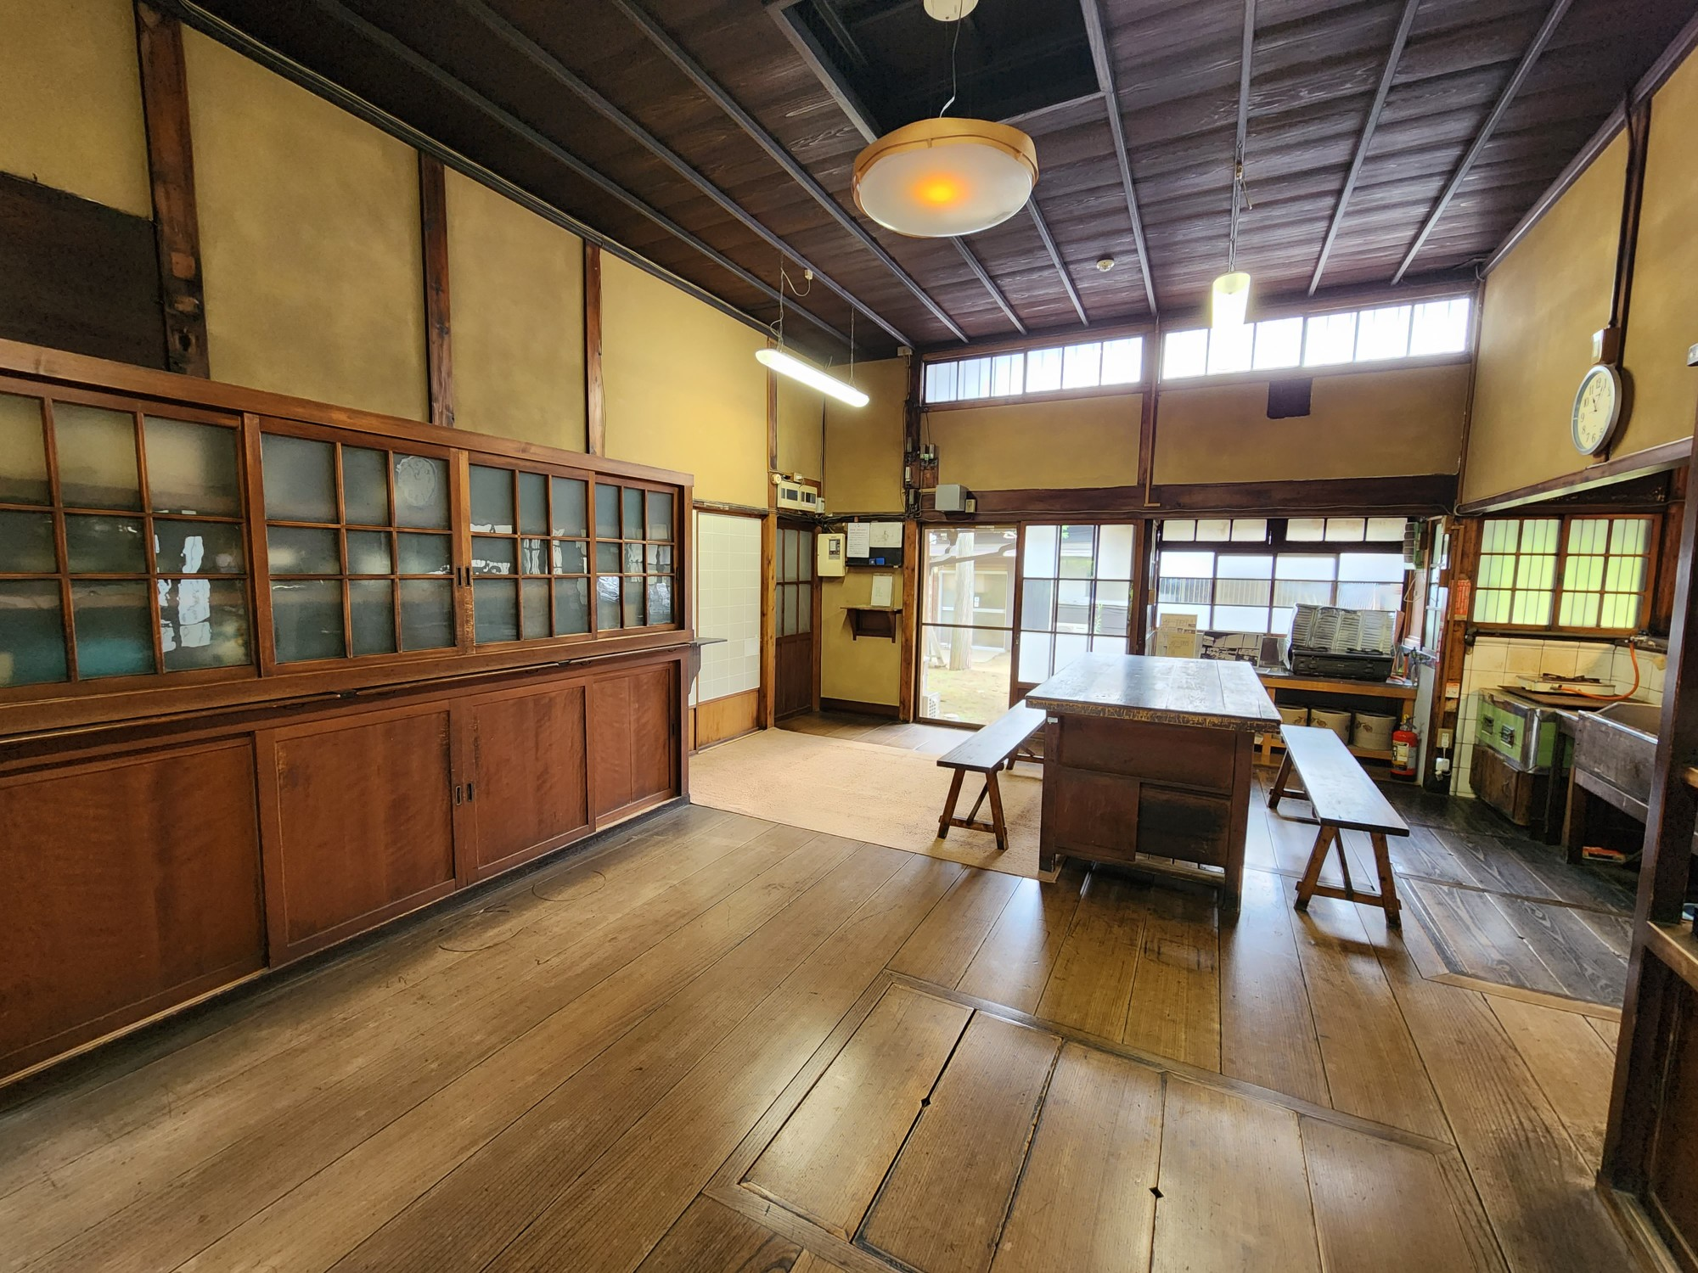
台所

Slide 11
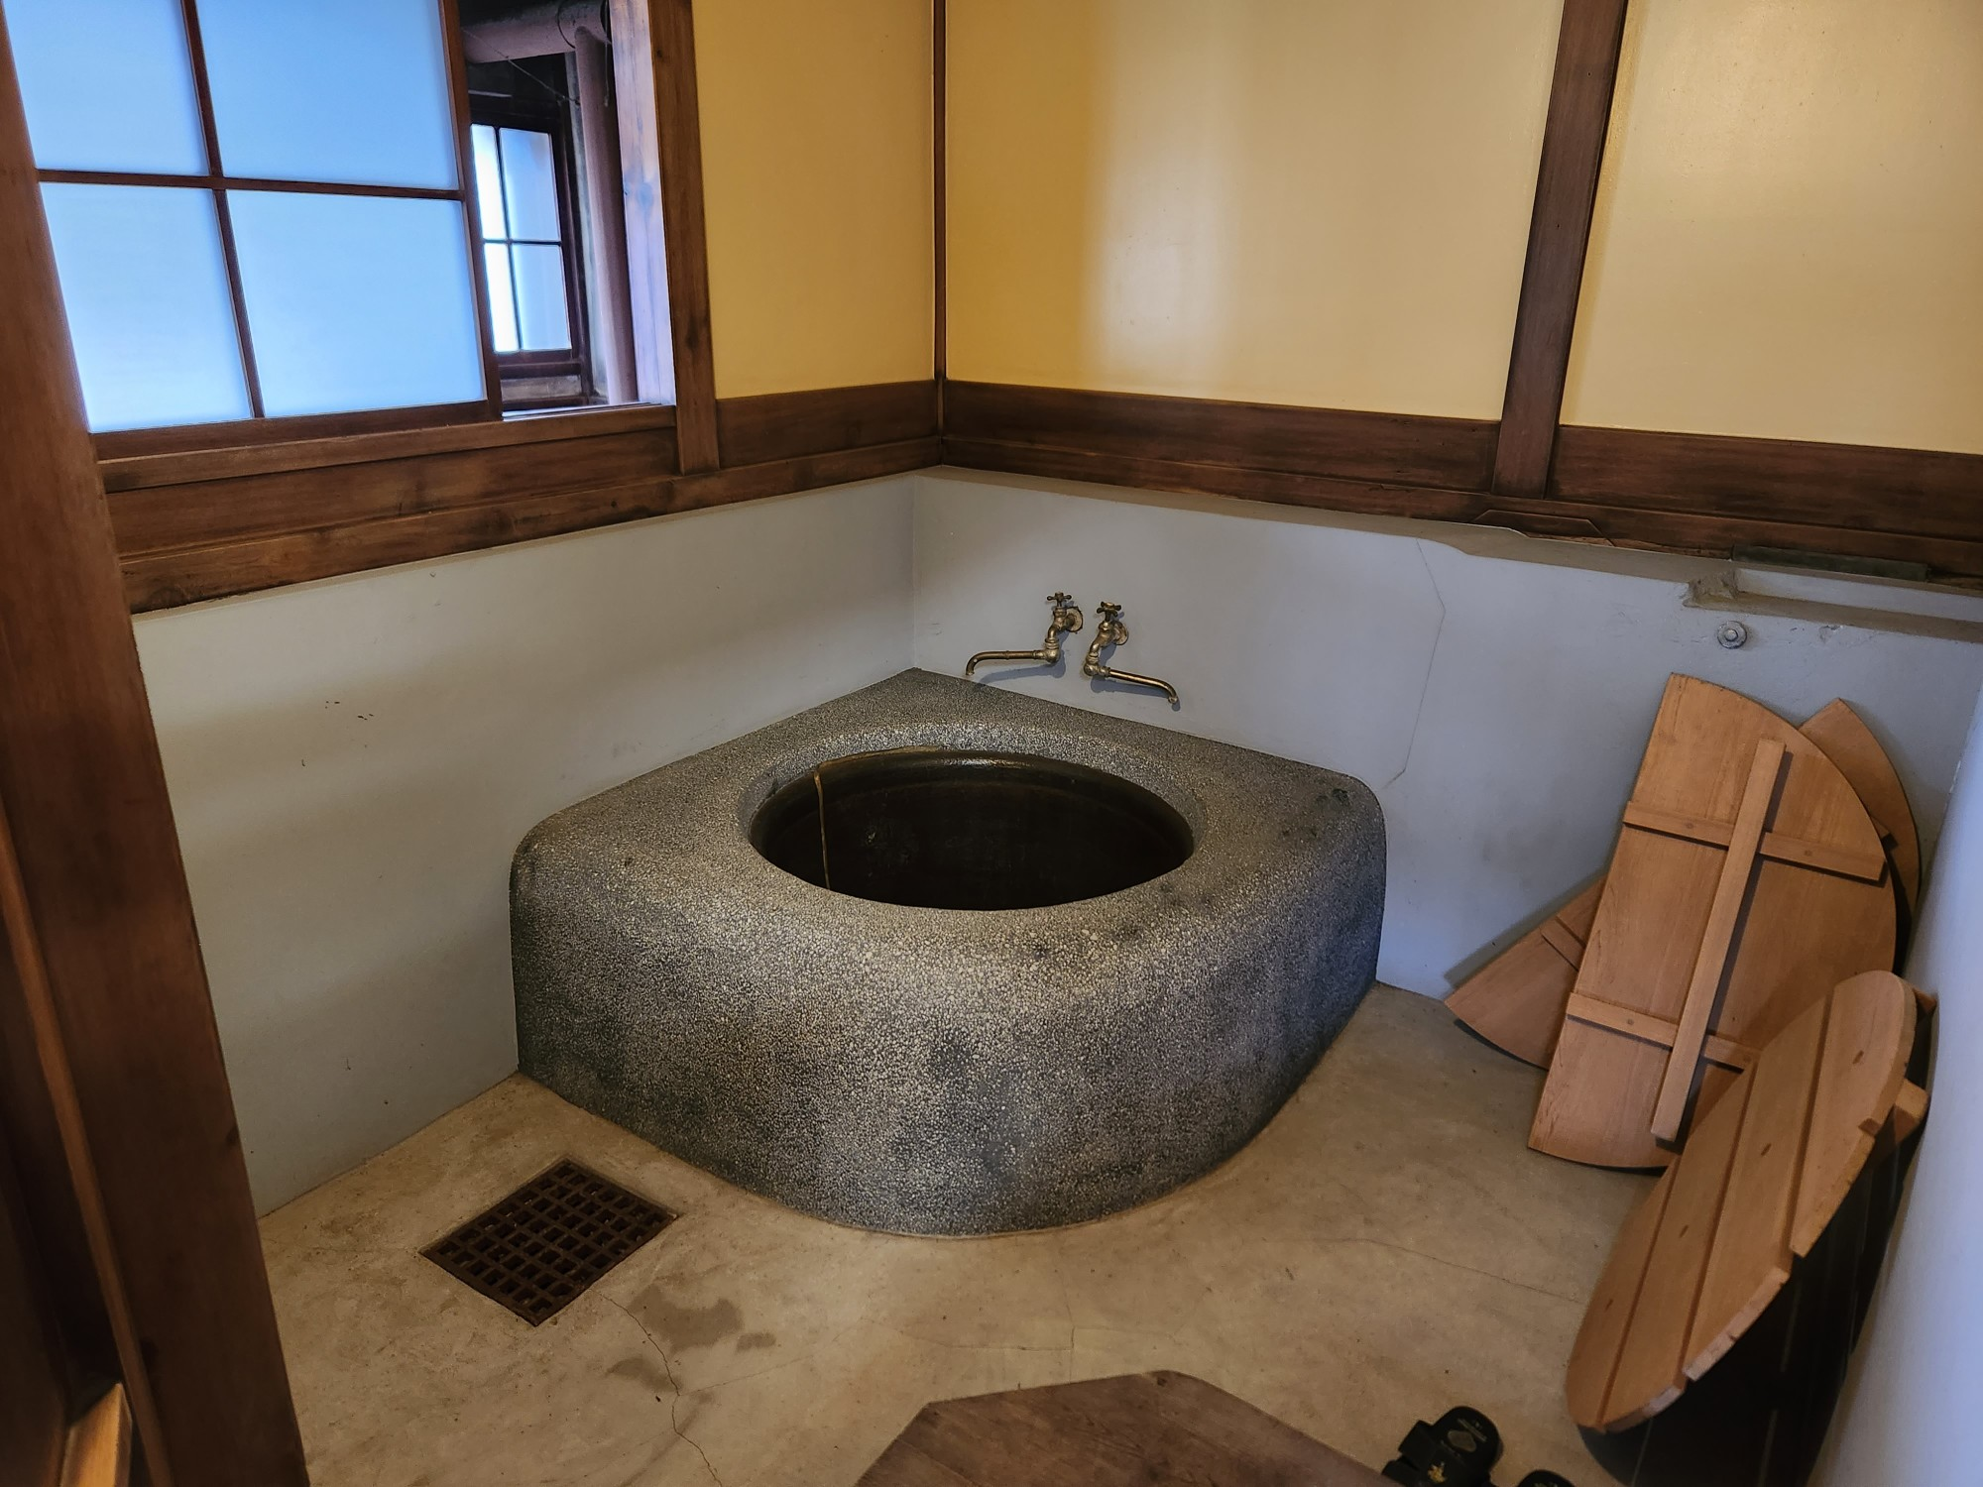
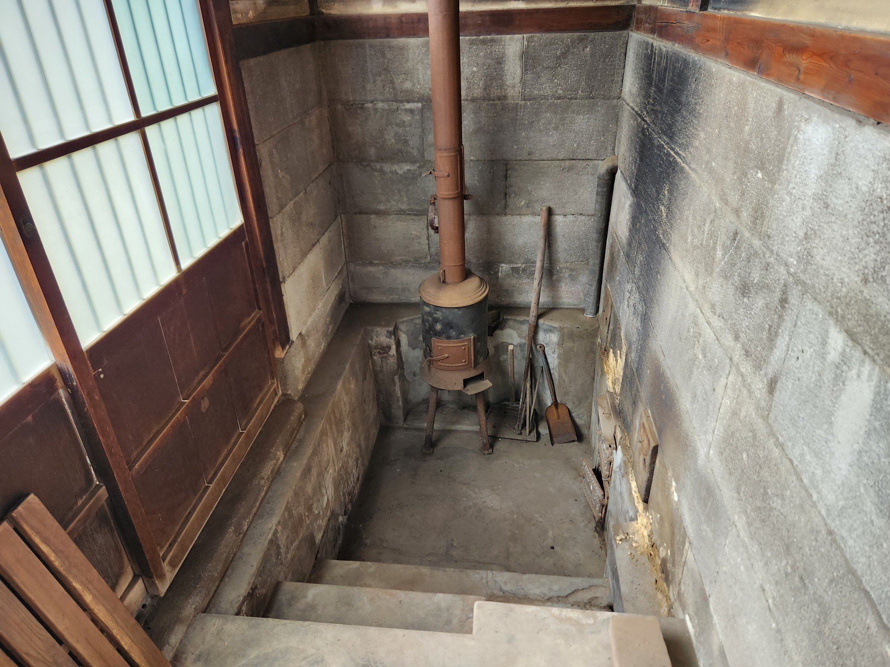
五右衛門風呂
薪窯

Slide 12
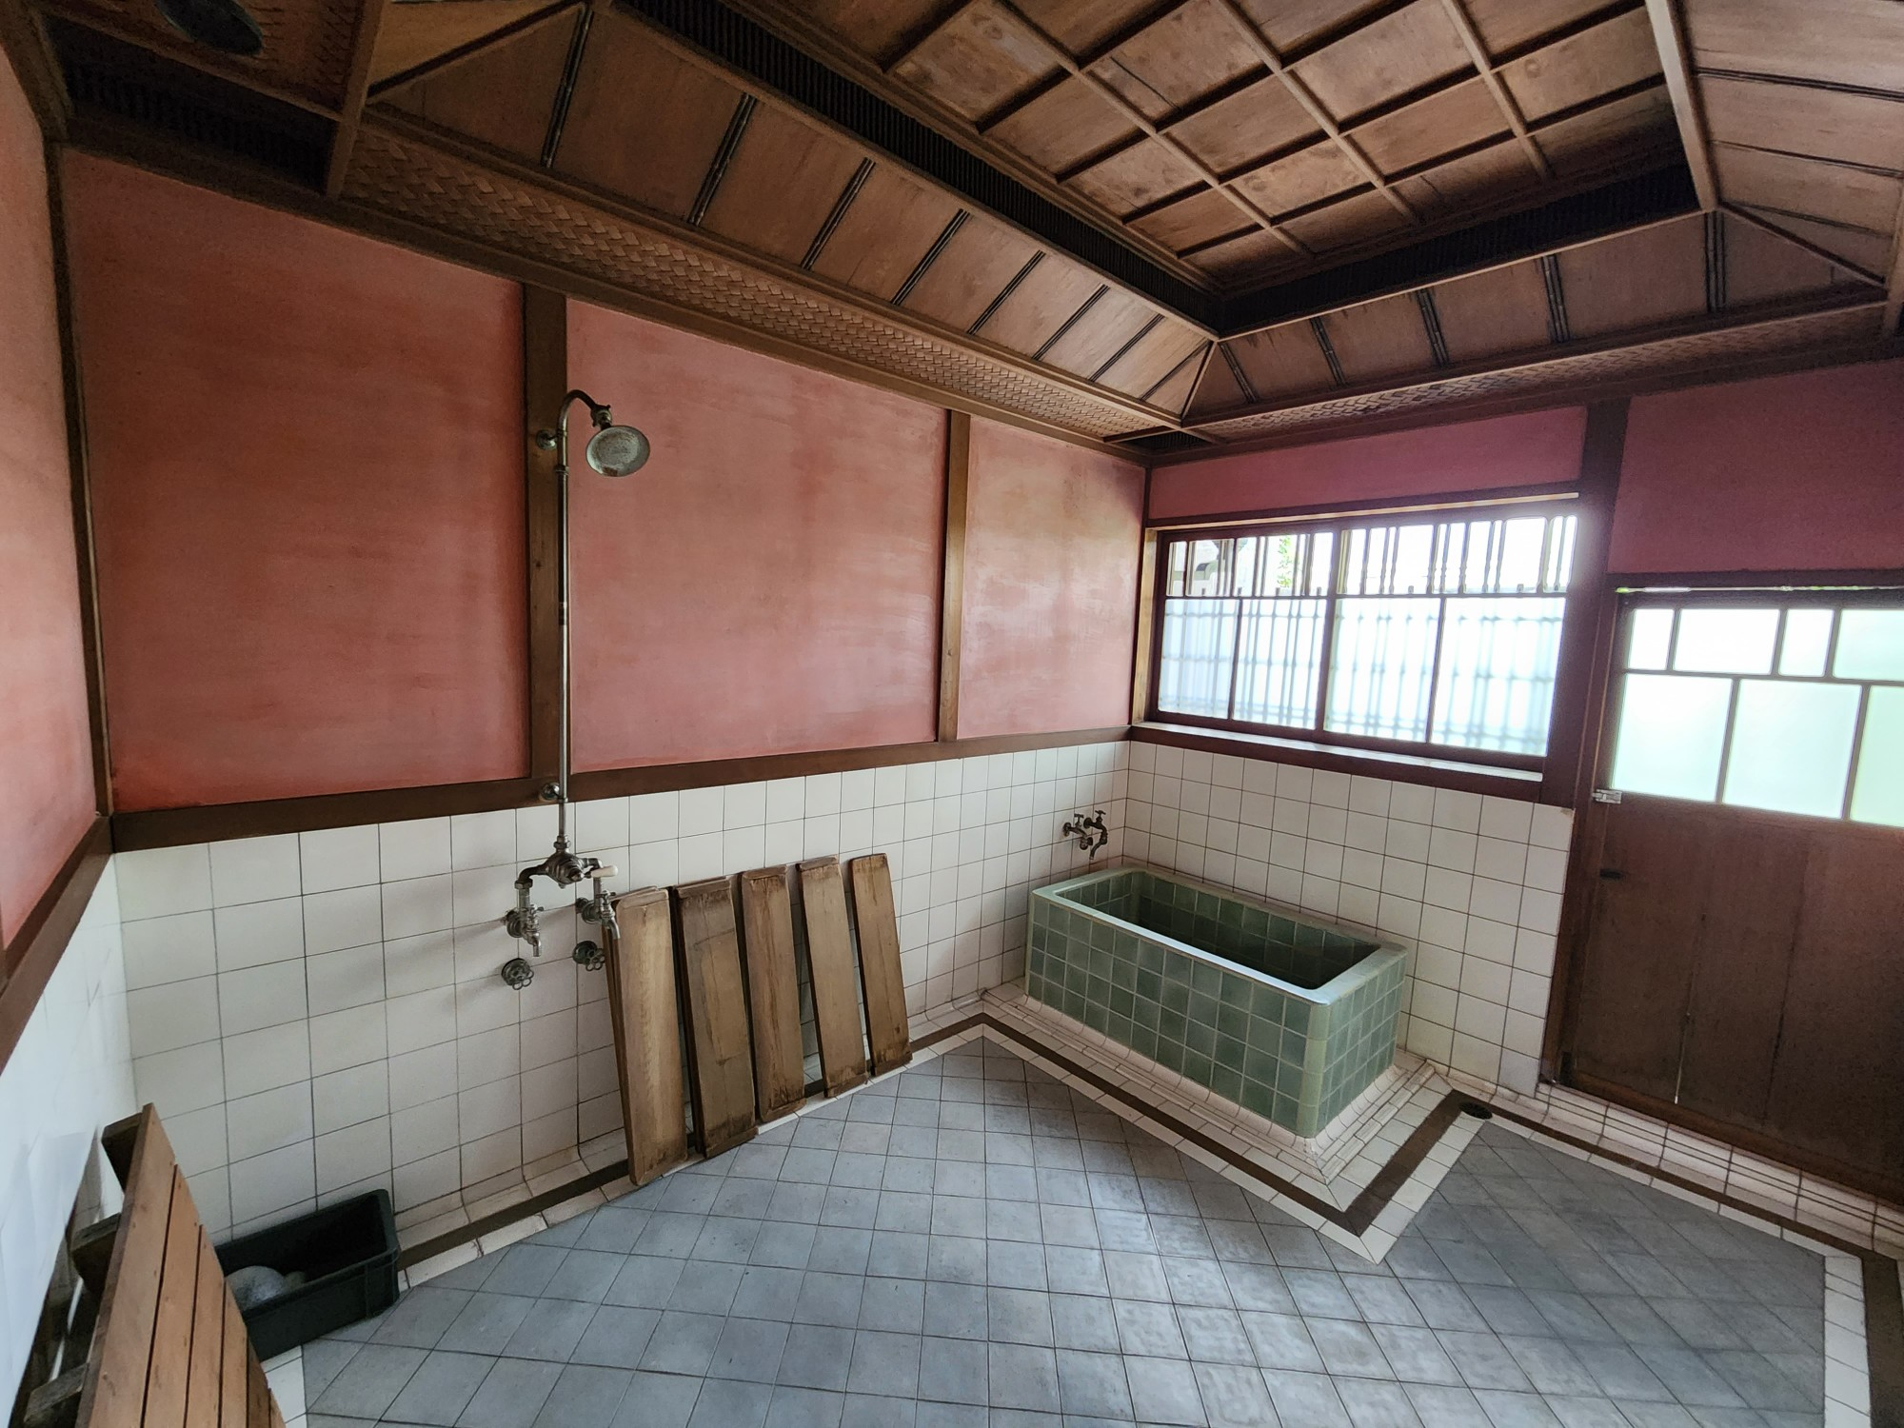
五右衛門風呂
お風呂

Slide 13
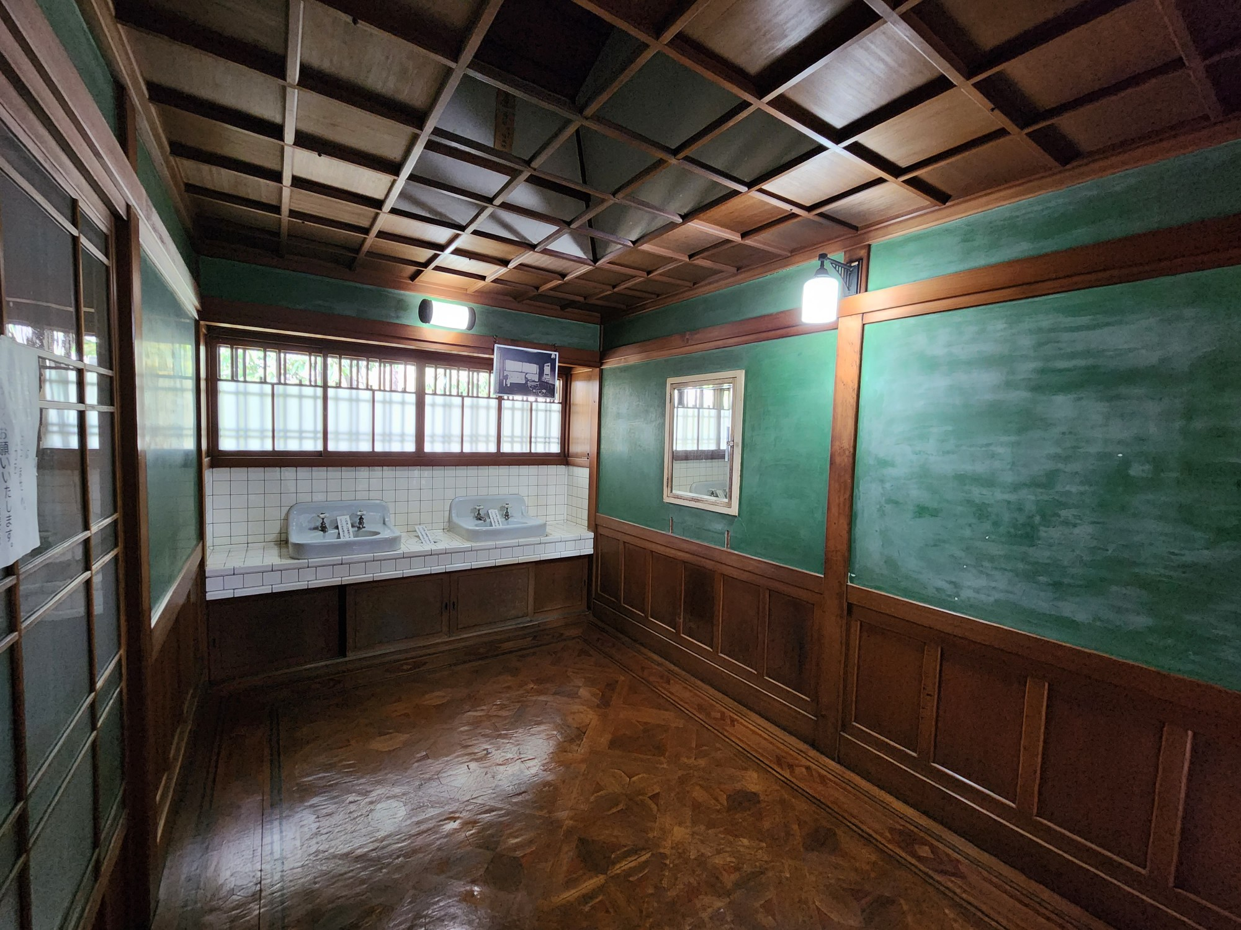
手洗い
お風呂

Slide 14
Homework
How many rooms are there in the Civic hall?
Which room is the most impressive for you? Why?
What kind of house did your grandparents live in?
What do you think of Australian old houses?
Which room can you explain easily to the Australian visitors?

Slide 15
SIA Lesson 2 Australian old houses

Slide 16
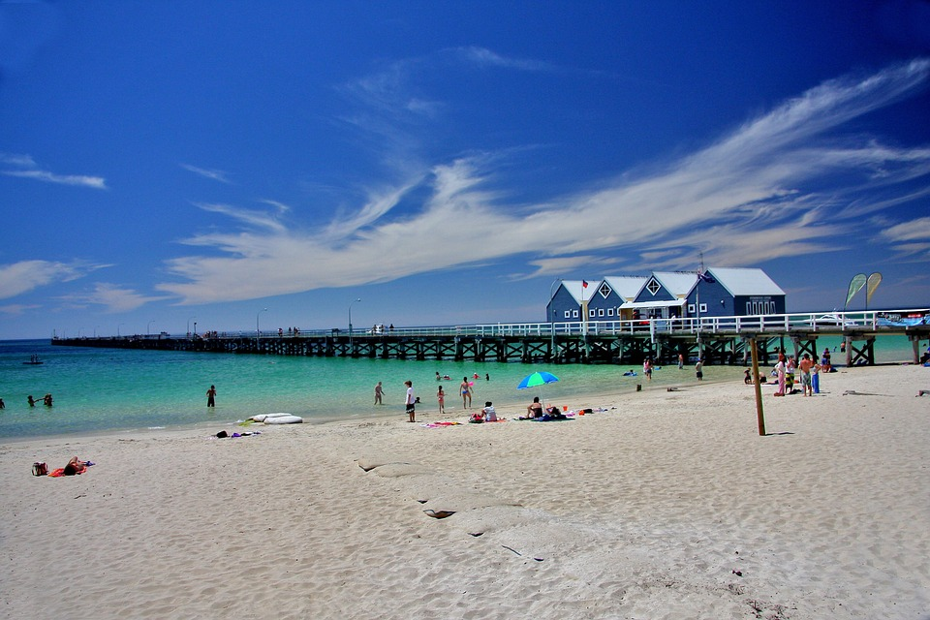
Busselton is a city in the South West region of the state of Western Australia approximately 220 km south-west of Perth. The city is best known for the Busselton Jetty, the longest wooden jetty in the Southern Hemisphere.

Slide 17
Building | Built | Notes
Old Butter Factory | 1918 | currently a museum and home of the Busselton Historical Society
Prospect Villa | 1855 | Built by James Chapman, oldest surviving house in Busselton

Slide 18
Building | Built | Notes
Weld Hall Theatre | 1874 | Mechanics Institute, RSL, Repertory theatre
Busselton Jetty | 1865–1911 | 1841m in length, damage by Cyclone Alby
St Mary's Anglican Church & Graveyard | 1845, 1852 1902, 1906 | built in stages church, Harmonium, bell tower, vestry John Bussell from whom the area takes its name is buried in the Graveyard

Slide 19
St Mary's Anglican Church rectory | 1895 | Built in 1895 there are suggestions that it wasn't occupied until 1906
St Joseph's Roman Catholic Church | 1933, 1971 | Built in 1933 to replace the former 1866 building renovated in 1971
Villa Carlotta | 1896–1904 | Convent until sold 1952, since 1952 hotel accommodation

Slide 20
Group work activity
Make two groups and discuss these questions.
Where is the best place to build a house in Japan?
What materials would you use to build the house?
What features are important for a house?

Slide 21
Types of architectural designs
Colonial
Gothic
Victorian
Romanesque
Vernacular

Slide 22
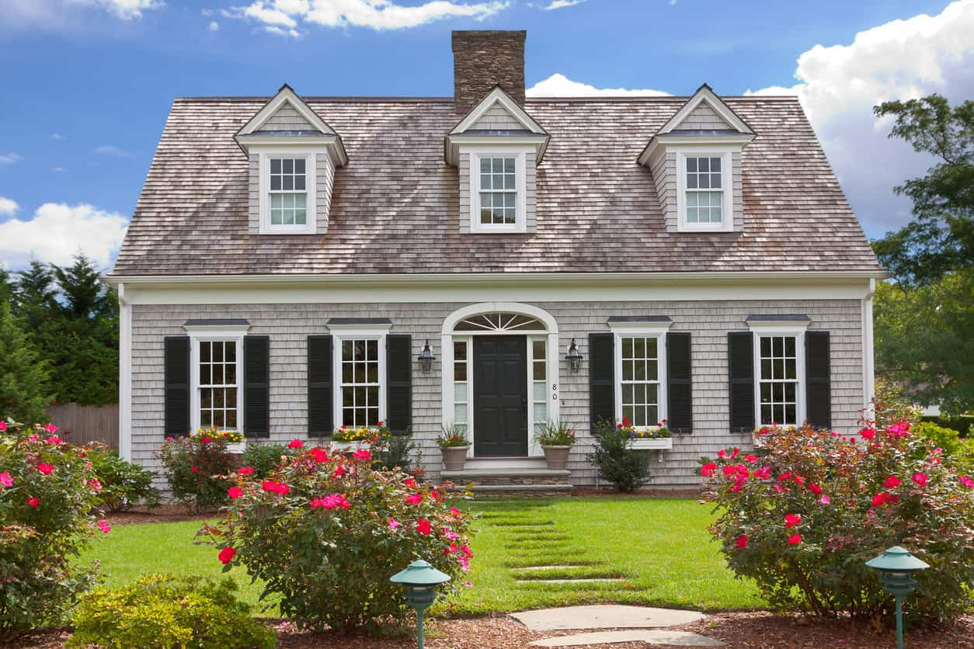
Colonial architecture is a mixture of architectural style that started as colonists combined architectural styles from their country of origin with design characteristics of the settled country. They built houses and buildings in a style that was familiar to them but with local characteristics more suited to their new climate.

Slide 23
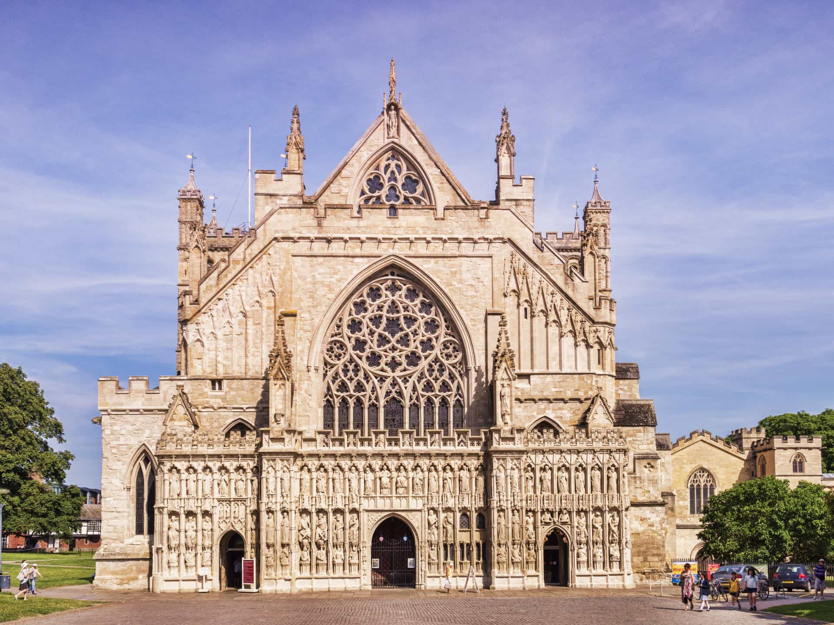
Gothic architecture is an architectural style that was prevalent in Europe from the late 12th to the 16th century, during the High and Late Middle Ages, surviving into the 17th and 18th centuries in some areas.

Slide 24
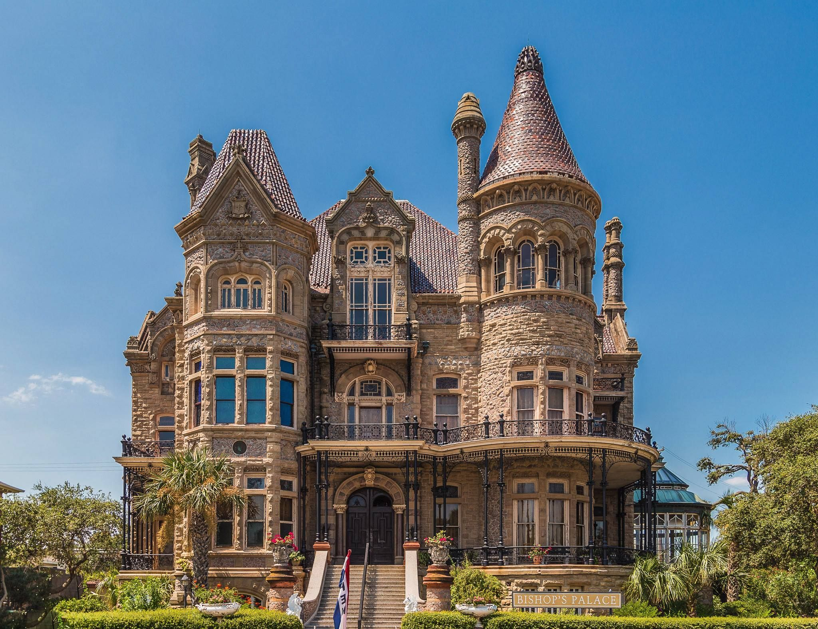
Victorian architecture
In the history of the United Kingdom and the British Empire, the Victorian era was the rule of Queen Victoria, from 20 June 1837 until her death on 22 January 1901.

Slide 25
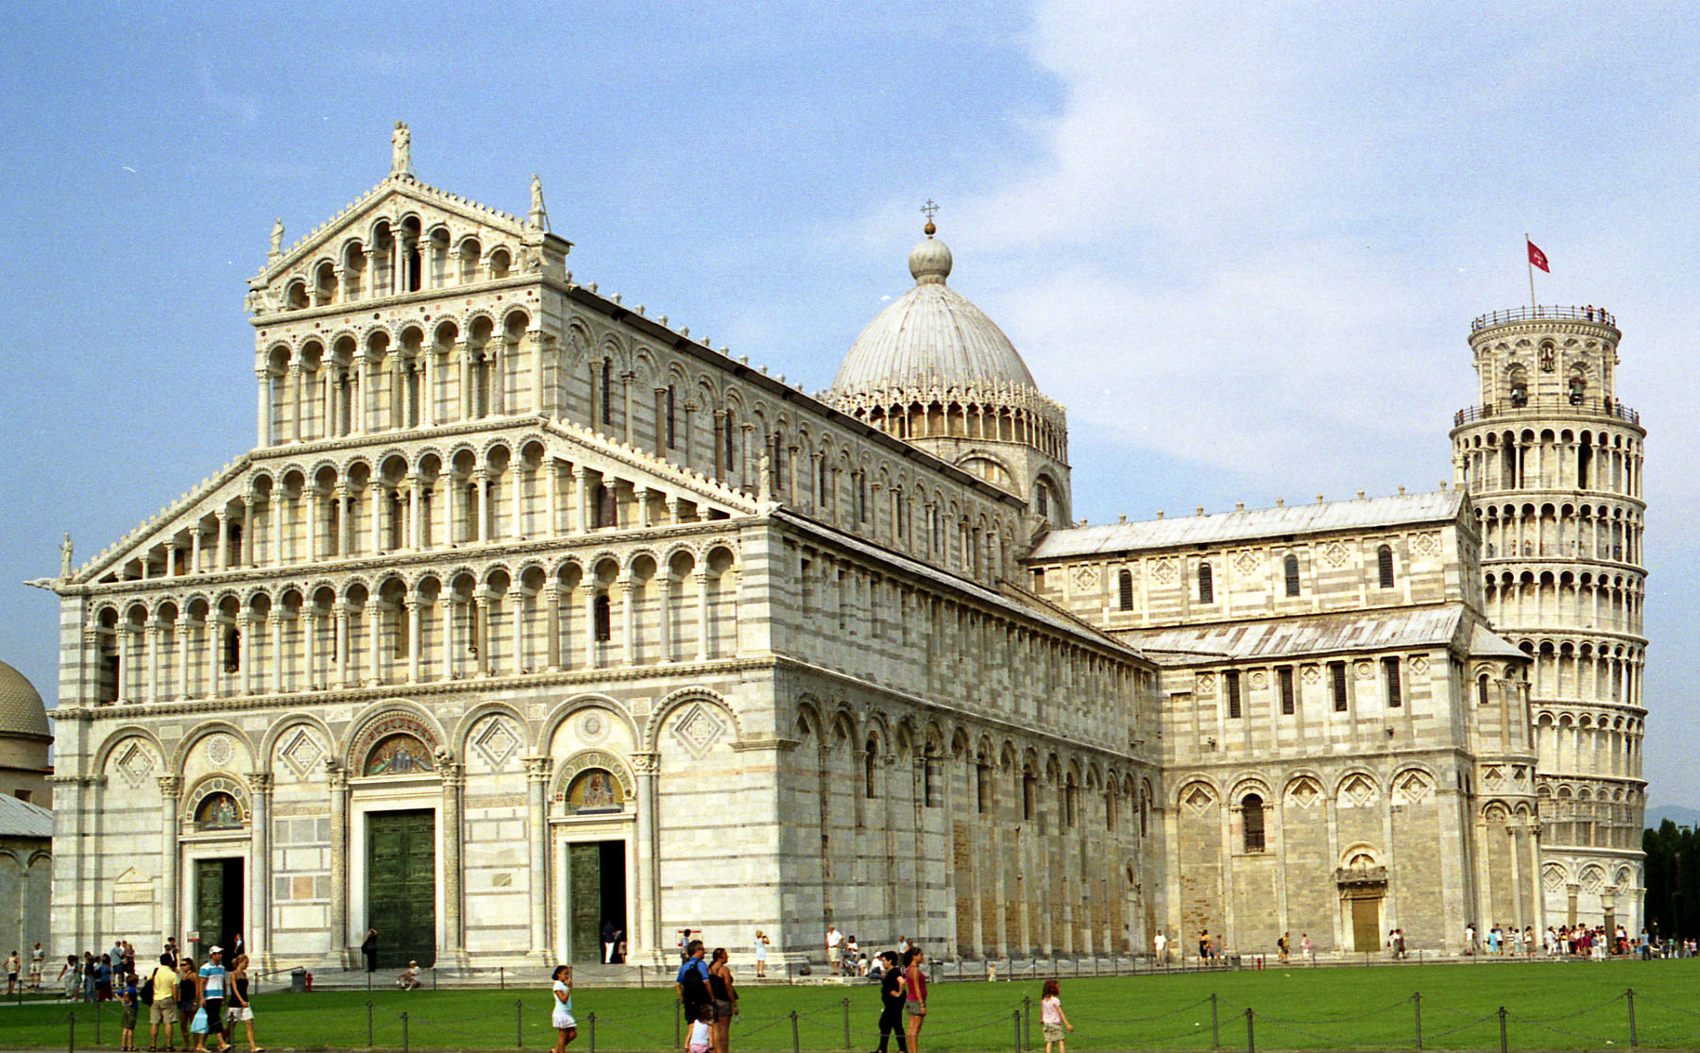
Romanesque architecture emerged in Europe in the 11th century, blending Roman, Byzantine, and Germanic influences. It is an architectural style characterized by semi-circular arches.

Slide 26
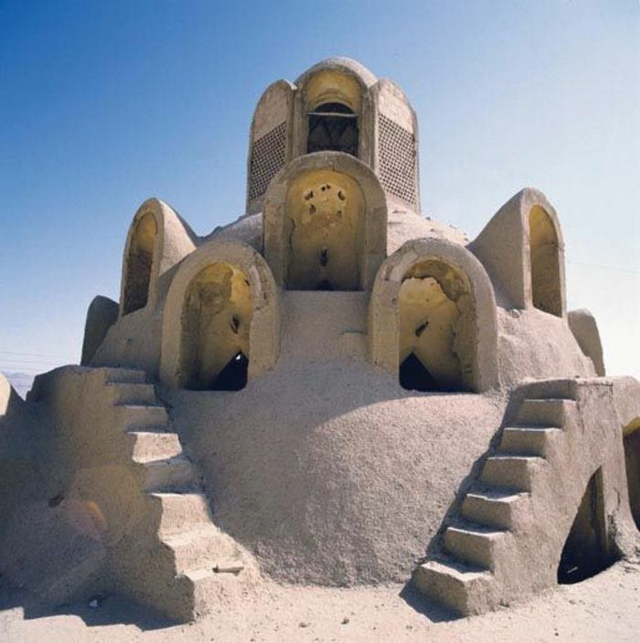
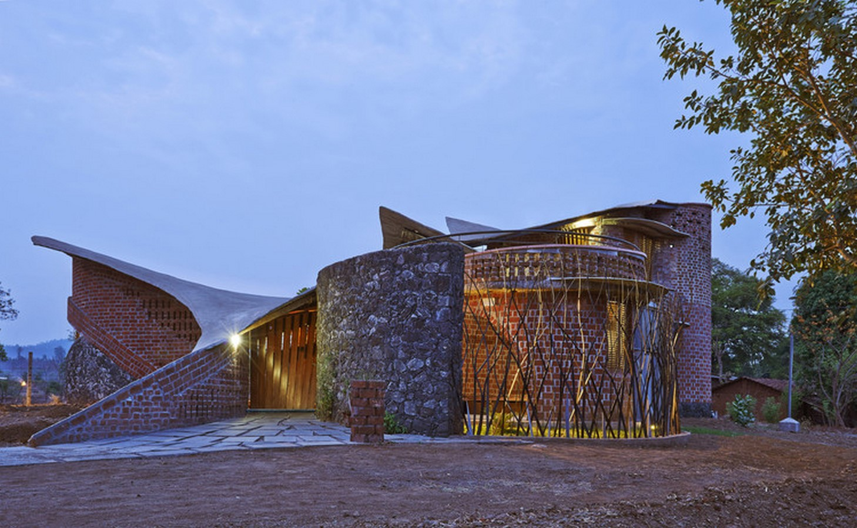
Vernacular architecture is building done outside any without professional guidance. It is not a particular architectural movement or style, but rather a broad category, about a wide range and variety of building types, with differing methods of construction, from around the world, both historical and extant and classical and modern. Vernacular architecture constitutes 95% of the world's built environment.

Slide 27
The End

